Slide 1


Blood Pressure Estimation using a Smartphone Camera
Department of Electrical Engineering
Students: Dan Ben David & Topaz Aharon
Supervisor: Yair Moshe
Project A
Spring, 2020

Slide 2
Presentation Outline
Project’s goal
Motivation and Challenges
Chosen PPG Technique
Previous projects’ work
Equipment: BP monitor, Oximeter
What so far, and what in Future work
Notes:
Backgound will get inside the motivation and challenges part

Slide 3
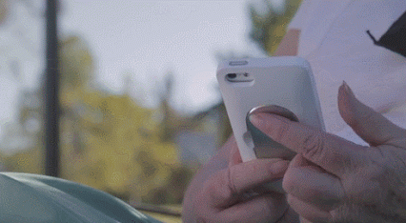
Project’s Goal
Estimate blood pressure values using a
smartphone camera.
PPG – Photoplethysmogram, BP- blood pressure
Notes:
Reliable and Comfortable BP results anytime & anywhere

Slide 4
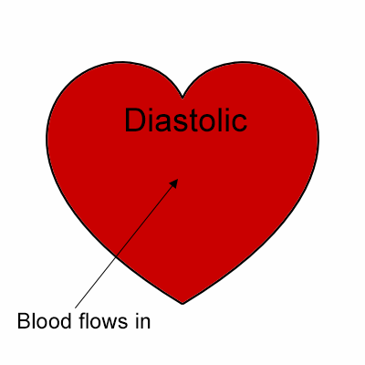
Blood Pressure
Pressure exerted upon the walls of blood vessels
Expressed in terms of systolic/diastolic pressures
Measured in mm Hg
Notes:
Blood pressure
The pressure exerted by circulating blood upon the walls of blood vessels
Systolic – a top number, when the heart muscle contracts
Diastolic – bottom number, when the heart muscle is resting between beats
Normal Blood Pressure is less than 120 over 80 mmHg (millimeters of mercury)

Slide 5
Blood Pressure Importance
High Blood Pressure – “Silent Killer”
Low Blood Pressure has also it’s negative effects
Blood pressure is varying – monitoring capability is critically important
Notes:
Blood pressure is important because the higher your blood pressure is, the higher your risk of health problems in the future. If your blood pressure is high, it is putting extra strain on your arteries and on your heart.
High blood pressure can cause a heart attack, a stroke, kidney disease or dementia.
Low blood pressure can cause dizziness, and in extreme cases, fainting and seizures.
Blood Pressure is varying depending on situation, activity, and disease states – therefore being able to monitor its values might be critical for some people

Slide 6
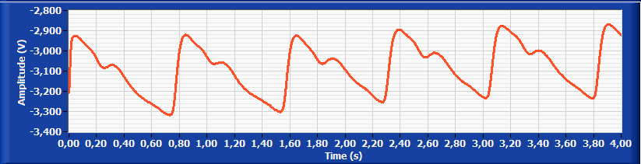
Photoplethysmogram (PPG) & PPG Signal
Optical technique for blood volume changes during a cardiac cycle
Measures several physiological vitals
Consists blood-flow & respirational components
Non-invasive
Low-cost
Notes:
Photoplethysmography (PPG)
Photoplethysmography (PPG) is a simple optical technique used to detect volumetric changes in blood in peripheral circulation
It is a low cost and non-invasive method that makes measurements at the surface of the skin
Waveform consists of AC component related to changes in blood flow and varying DC “baseline” related to respiration
High peek identified with systolic
Low peek identified with diastolic

Slide 7
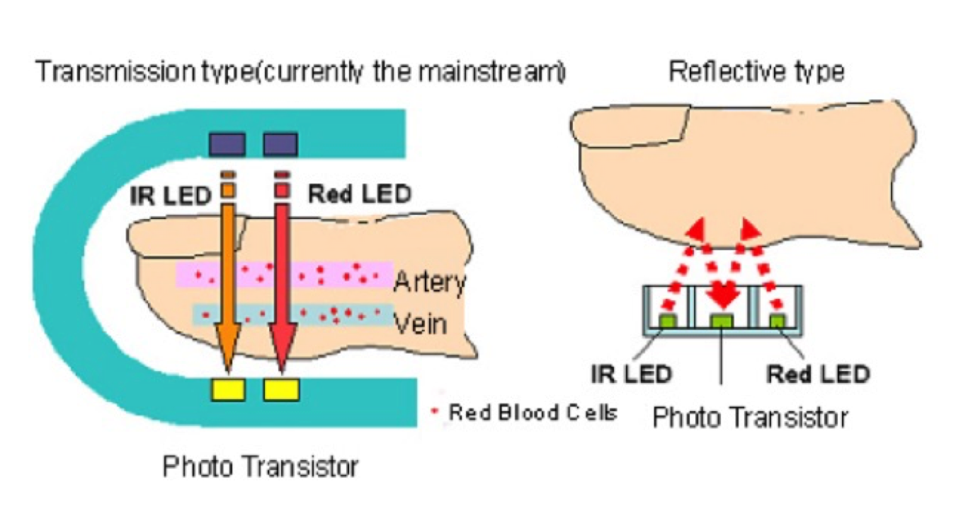
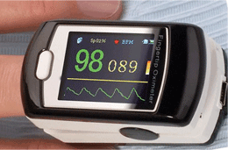
Obtaining PPG Signals
PPG is obtained by illuminating the skin and measure absorption
Two detection ways: transmission and reflective
Main device: Oximeter
Notes:
Obtaining PPG Signals
PPG is obtained by illuminating the skin with the light and then measuring the amount of light either transmitted or reflected to a photodetector converted to DC and results the PPG
Because blood promotes swallowing higher than other tissues (skin, bone, etc.) changes in blood flow translate into changes in the signal of PPG (about 2 percent of light intensity).
The use of two wavelengths red and infrared can reveal, through the ratio of the ingestion of these wavelengths to Hemoglobin, the blood oxygen level and allows to draw conclusions about the “baseline” signal.
Two ways to detect the PPG signal: transmission and reflective
Main device: Oximeter
“We want to simulate the same idea with the smartphone camera and its flash …”

Slide 8
Smartphone’s Motivation
Accessibility
Simple Operation
No additional costs
Notes:
“We want to simulate the same idea with the smartphone camera and its flash …”
Smartphones are already possessed by most people at all age’s range
Accessibility – unlike reliable home BP devices, smartphones are compact and mobile
Simple operation – Using your personal smartphone’s camera requires no instruction at all
No additional costs - Saves the costs of purchasing a BP separate product

Slide 9
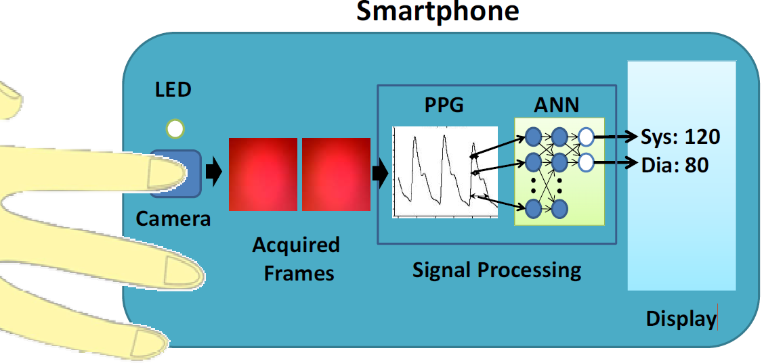
Blood Pressure Measurement from smartphone By Capturing The Fingertip, and using Machine learning (Banerjee et.al, 2015 & Lamonaca et.al, 2013)
Notes:
1st stage – Smartphone’s Fingertip shot with flash on, resulting with a video
2nd stage - Extract the PPG signal out of the video, using various techniques that will be described below
3rd stage - The signal is extracted for learning, and with the aid of a learning system (e.g. a network of neurons) we obtain the blood pressure value
Video to PPG requirements
We should note that environmental interruptions may accrue, therefore the method should be robust in various conditions(light, noise etc.)
Minimum relying on user’s proper use
Points mentioned are crucial given the fact people will use it under varying conditions and it should stay accurate

Slide 10
Difficulties using Smartphones to capture PPG
Technological limitations of Smartphones cameras
White light vs infrared & red lights simultaneously
Sampling rate of 30fps vs 120-3000Hz in clinically devices
Variety of Smartphones(cameras)
Noisy signal
Notes:
Measuring the signal with the smartphone instead of a medical device poses several difficulties
The smartphone uses white light that consists number of wavelengths in the visible field as opposed to two wavelengths with two different detectors that are commonly used.
This produces a noisier signal consisting of a wavelength positioner having different swallowing locations and making it difficult to measure parameters such as oxygen level and SNR magnifier.
30 Hz sampling rate as opposed to 120 Hz in clinically validated device
an article claims that a minimum sampling rate for a "sufficient" form of PPG signal is 22 Hz.
fps = frames per second.
Variety of Smartphones(cameras)
Different smartphone devices have different cameras that are built differently so that different color channels and camera resolution are obtained.
FOR EXEMPLE: to strong of a flash will make a “burn” like feeling with same phones
Noisy signal
Smartphone measurement conditions are not as sterile as medical measurement and are influenced by various environmental factors (especially lighting conditions).
* The previous project come to the conclusion that we probably , have all the data we need in the PPG signal in order to estimate the BP

Slide 11
Offline
PPG with BP label
Preprocess data
Training
MIMIC Model
Project B – MIMIC dataset base
Smartphone PPG with BP label
Transfer learning
Smartphone Model
Online
Video from smartphone
Video TO PPG signal
PPG signal
Preprocess PPG signal
Blood Pressure estimation (BP)
Systolic/Diastolic values
Project A – Video To PPG signal
Notes:
Project A is referring to the work has been done by Shay Shimonov & Ron Gatenio
Project B is referring to the work has been done mostly by Oded Schlesinger & Nitai Vigderhouse
Our focus will be on three parts
First - Preprocessing PPG signals extracted from a smartphone camera. We’ll use an Oximeter as reference in order to discover Smartphone PPG Output’s unique characterizations and limitations.
Second – Building Smartphone Dataset
Third - Building a new shallow NN in order to execute Transfer Learning technique over the NN MIMIC model.

Slide 12
Previous Project’s work Shay Shimonov & Ron Gatenio, 2017
Projects A :
Video to PPG using smartphone camera
Projects B:
First steps for PGG to BP using ML (didn’t yield good results)
Notes:
In our project, we are leaning on the significant work has been done in previous projects at SIPL by other students. Yet, we’ve found a lot of room for improvements and new ideas in order to get to breakthrough results.
A – project produced 3 most compatible techniques out of various techniques were already out there
B – Aimed for a machine learning solution , didn’t lead good results

Slide 13
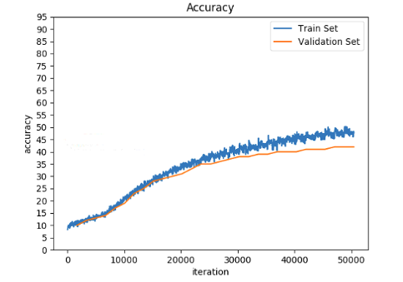
Previous Project’s work Ido Lev & Inbal Ronai, 2018
Project A :
NN training based on STFT images
Tried to solve a regression problem using classifications techniques
Notes:
Dataset arrangements - Partition of the dataset to 100,000 different 30 seconds windows of PPG and blood pressure signals
Using MIMIC2 database in order to train an ANN by using STFT images of PPG signals (42% results on training set)
Tried to solve a regression problem using classifications techniques – leads to big deviations for “border measurements” : 42% success on test set (tested by Nitai & Oded)

Slide 14
Previous Project’s work Oded Schlesinger & Nitai Vigderhouse, 2019
Project A :
Preprocessing of dataset (using 5% of MIMIC2)
Project B :
Using MIMIC2 database in order to train a CNN
Dealt with the suitable problem – Regression , measuring MAD
Notes:
Preprocessing of dataset – significant work lead to the use of only 5% to train the net (may resulting with a narrow scope of BP estimation capabilities)
On second calibration-free technique were based on each patient’s 1st measurement for calibration.
This technique achieves a more accurate measurement by estimating BP changes with respect to a patient's PPG and ground truth BP values at calibration time.
Using MIMIC2 database in order to train a CNN - Training on the whole data yielded 82% success rate.
Dealt with the right problem Regression, measuring MAD
Accuracy achieved is very promising !!!
Papers written for ICASSP & Critical Care Exploration !!!
Didn’t get to transfer learning stage for smartphone application.

Slide 15
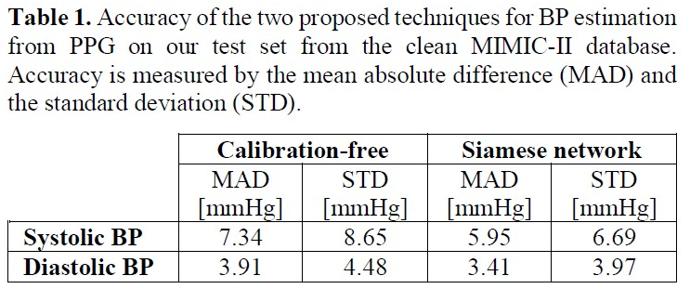
MAD – Mean Absolute Difference
AAMI = Association Advancement Medical Instrumentation
Measurement Technologies should not be greater than 5 mmHg
Deviation should not be greater than 8 mmHg
Home BP difference of 5 mmHg or higher is common
Noninvasive Technologies expected similar accuracy
Oded, Nitai, Danny, Yair. “ICASSP 2020 - 2020 IEEE International Conference on Acoustics, Speech and Signal Processing (ICASSP).”
Notes:
How do you find the mean absolute difference?
(1) Find the mean value
(2) Find the absolute value of the difference between each data value and the mean: |data value – mean|.
(3) Find the sum of the absolute values of the differences.
(4) Divide the sum of the absolute values of the differences by the number of data values
The Association for the Advancement of Medical Instrumentation (AAMI) recommends that the mean absolute difference (MAD) of noninvasive BP measurement technologies should not be greater than 5 mmHg
The standard deviation should not be greater than 8 mmHg compared to a reference method.
Home BP measuring devices may be inaccurate in 5% to 15% of patients, and a difference of 5 mmHg or higher is common.
BP measurements of other noninvasive technologies are expected to have at least similar accuracy, so they are at least as reliable as home BP measuring devices.
The higher accuracy diastolic BP estimation versus systolic BP estimation is explained by the lower variance of the diastolic BP
Systolic(high)/Diastolic(low)
We have discovered that systolic blood pressure (the top number or highest blood pressure when the heart is squeezing and pushing the blood round the body) is more important than diastolic blood pressure (the bottom number or lowest blood pressure between heart beats) because it gives the best idea of your risk
STD = Standard Deviation
MAD = Mean Absolute Difference

Slide 16
Current Project’s work Omer Shulam & Kfir Pardessi , 2020
Project A :
Preprocessing - MIMIC 3 , building dataset using oximeter.
Notes:
Preprocessing of dataset – extending the scope of measurements for the ANN using oximeter in order to get better results on Test Set

Slide 17
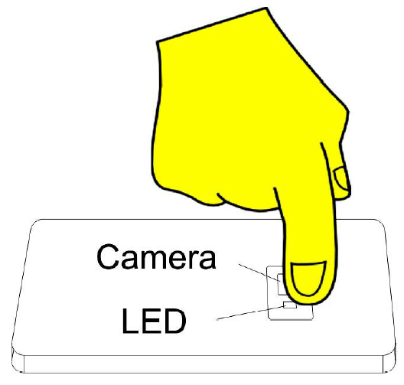

PPG Extraction from Fingertip Video Chosen technique
Three different techniques were presented
Focusing on 2nd Algorithm
Notes:
Three different technics were presented - On previous works, after examining different video2ppg techniques, they produced three ways to extract video2ppg
Focusing on 2nd Algorithm - to this point we’ll focus on one which gave us best results, this is the only ON-LINE algorithm out of the three, can handle variety of conditions which fits our usages the most

Slide 18
Technique #2 Advantages
Robustness for different light conditions
Robustness for different user skin characteristics
Robustness in cases of wrong usage
Online calculation
Online calculation limitations
Technique #2 Disadvantages
Notes:
Advantages
Adaptive threshold – achieves robustness for different light conditions and user skin characteristics
Frame selection – achieves robustness in cases of wrong usage
Disadvantages
No proper denoising is applied due to online calculation

Slide 19
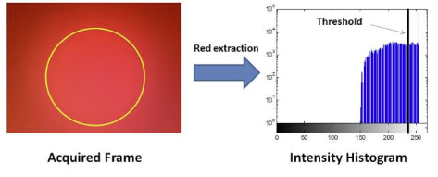
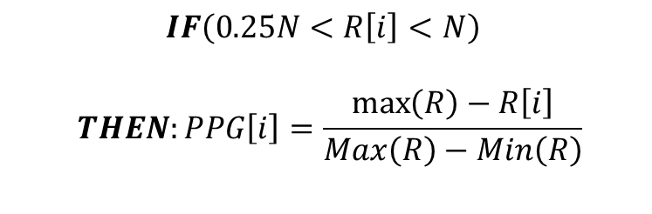
Technique #2 – how it work
Find the threshold Value of the red channel
Remove problematic frameworks
Create the PPG signal
$$IF\left(0.25N<R\left[i\right]<N\right)$$
$$THEN:PPG\left[i\right]=\frac{\max\left(R\right)−R\left[i\right]}{Max\left(R\right)−Min\left(R\right)}$$
Notes:
build
1- we work on few first frames; we look at the red channel. Find the 75% of the luminous and from that we take the minimum value to work with as are threshold
2-remove all the frame that 25% or move of there pixels are above the threshold, and if all the pixels are at the threshold.
3- for the remainder of the frame we look of how must pixels with the threshold value. And say the $PPG\left[i\right]=\frac{\max\left(R\right)−R\left[i\right]}{Max\left(R\right)−Min\left(R\right)}$.

Slide 20
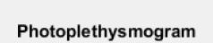
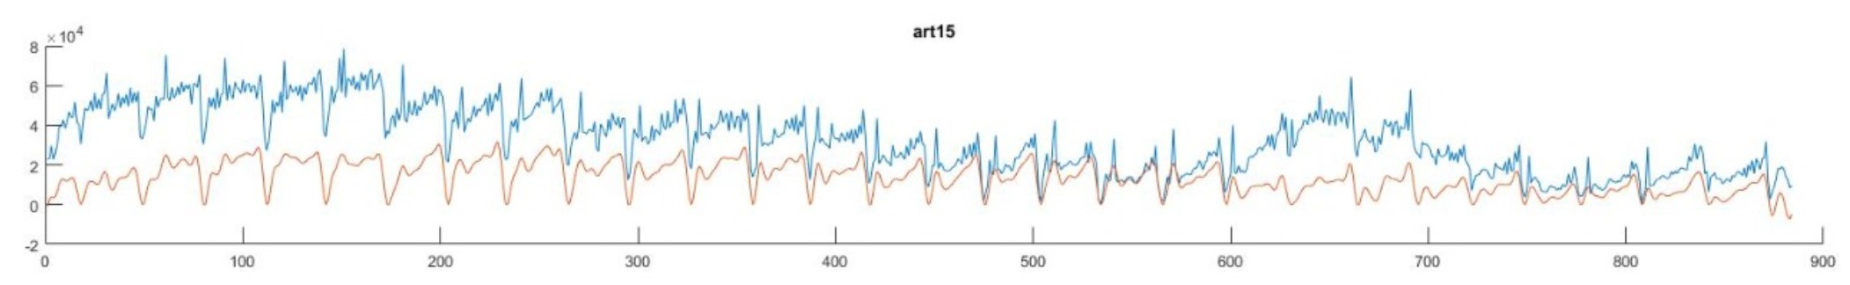
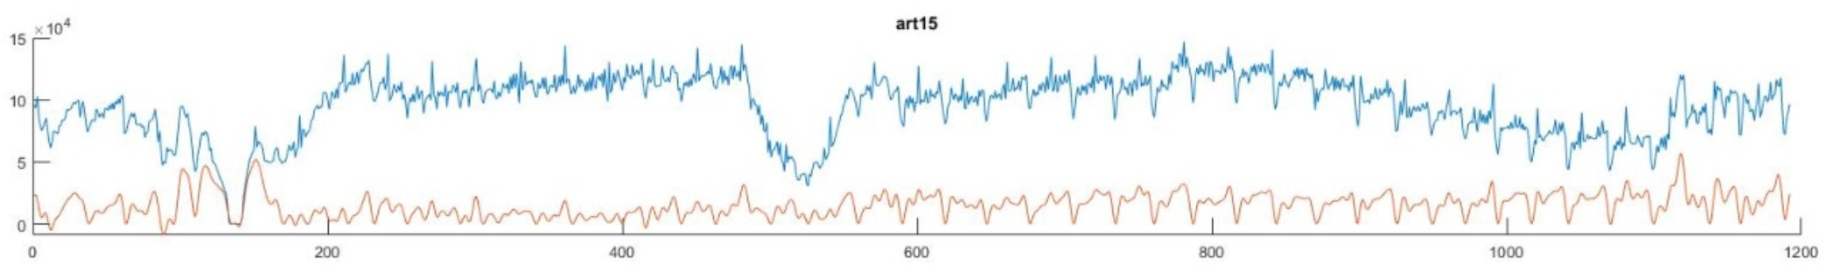
Technique#2 results by Galaxy s9
Camera specifications: 4K@30/60fps, 1080p@30/60/240fps, 720p@960fps, HDR, stereo sound rec., gyro-EIS & OIS (30fps)
At rest
Pulse
Time
Baseline
Raw signal
After exercise
Pulse
Time
Notes:
LPF and executing baseline procedure for alignment
Technique #2
One of the problems with self-used health monitoring system is that nobody except the person itself can control the correctness of the procedure.
Therefore, the system must detect all the cases of wrong usage (i.e. wrong position of the finger, using the system without placing a finger on the camera, the force with which the finger presses the camera, etc.).
Moreover, as it was already mentioned, the frames acquired from different cameras have different color saturation.

Slide 21
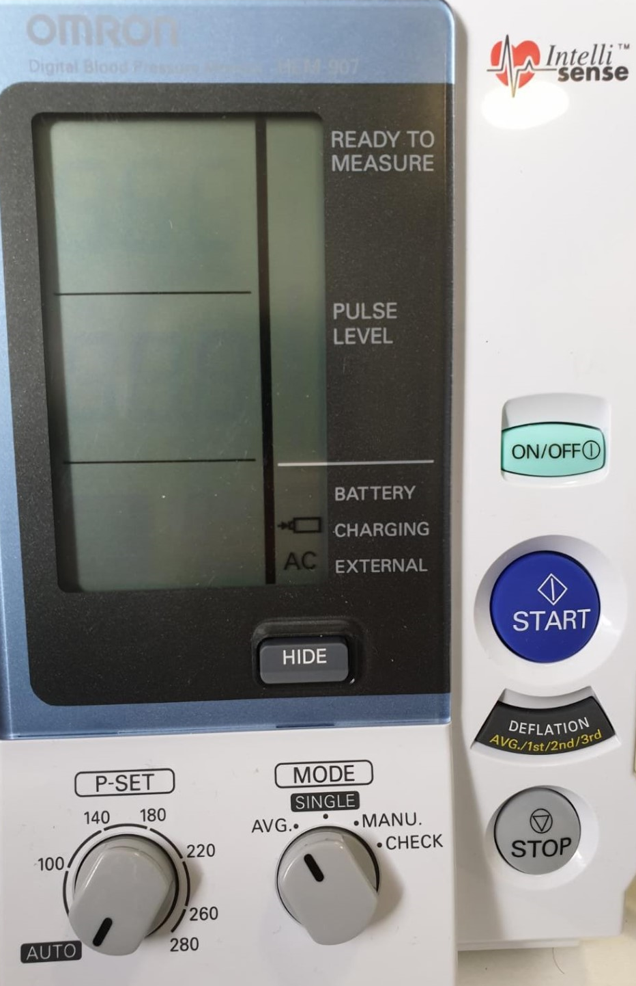
Omron HEM-907 - a clinically validated DIGITAL BLOOD PRESSURE MONITOR
Provides a finite and accurate systolic/diastolic results.
The lab acquired the device for us.
Notes:
The digital BP we were using is Omron HEM-907 .
As said in Omron official site, this is an automatic blood pressure monitor intended for use by medical professionals.
We are using BP monitor in order to label our Smartphone PPG Signal with BP, that way we’ll be able to compare it to ANN results.

Slide 22
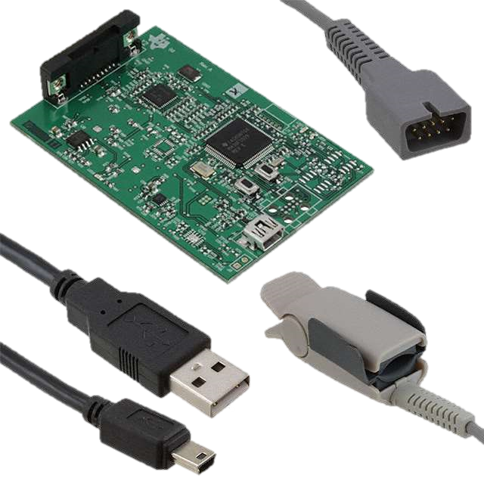
Texas Instruments Oximeter AFE4490 Evaluation Module
Provides raw signal in four channels
USB based power and PC application connectivity
Sampling rate of 500 Hz
Operated by TI GUI
transmission(not reflective)
Lab currently possessing 2 devices
Notes:
The oximeter instrument we’ll use is the Texas Instruments AFE4490 Evaluation Module [20].
We’ll use the Oximeter as reference in order to discover Smartphone PPG Output’s unique characterizations and limitations.
The device can record signals at frequencies up to 3000Hz and has 2 LEDs, one emitting infrared light and one emitting red light.
The component has a USB connection to the computer, and can be run via a downloadable GUI through the Texas Instruments website at:
http://www.ti.com/tool/afe4490spo2evm
The kit comes with a card that has an analog connection to the oximeter sensor on one side, and a USB connection on the other.
The Oximeter Sensor is a clippable attachment on the tip of your finger.

Slide 23
Work So Far
Preparing ahead
Briefly literature review
Previous Projects full inspection
Reproduce previous works achievements
Initial Smartphone’s Database collection
Notes:
Preparing ahead – Stanford Course & ML experiment , environments familiarity with Python PyCharm Libraries PyTorch etc.
Briefly literature review – papers and medicine relevant background
Previous Projects full inspection – Nitai & Oded , Shai & Ron previous work
Reproduce previous works achievements – were able to achieve good results with video2ppg module using our measurements
Initial Smartphone’s Database collection – we took several measurements, some at rest and some after exercise, fingertip videos via different smartphones and BP signals with OMRON HEM-907 device for ground truth as reference.

Slide 24
Future Work
Experiment Smartphone PPG Output’s on the last ANN
Preprocessing PPG signals extracted from Smartphone
Building Smartphone Dataset
Transfer Learning Technique over ANN MIMIC model
Notes:
First – experiment Smartphone PPG Output’s on last ANN achievement
We’ll understand the code written on last project and run several PPG outputs we took with smartphone in order to examine our starting point
Second - Preprocessing PPG signals extracted from a smartphone camera
We’ll use an Oximeter as reference in order to discover Smartphone PPG Output’s unique characterizations and limitations.
Third – Building Smartphone Dataset
After examining the proper preprocessing method, we’ll have to collect enough measurements for next step
Forth - Transfer Learning Technique over ANN MIMIC model
Building a new shallow NN in order to execute Transfer Learning technique over the ANN MIMIC model.

